Slide 1
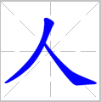
Review
Day 3
Review character 人、认、识、请、叫、吃
Review the radical meaning of 人、讠、口
Review the stroke orders

Slide 2
Day 3
Compare the Internal Structures
Think – Pair – Share:

Slide 3
Day 3
Identify the radicals & Stroke Order
艹
grass
辶
walk

